Slide 1
Letter to the Editor
www.aoifesnotes.com
Aoife O’Driscoll 2013

Slide 2
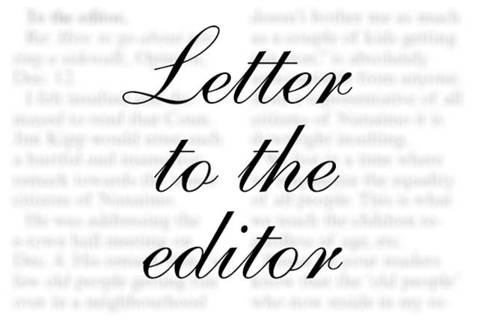
Layout
A letter to the editor of a newspaper must be laid out in a specific way.
You do not put your address at the top of the letter: you put it under your signature.
You do not write the editor’s address at the top of the letter.
You begin ‘Sir’ or ‘Madam’, depending on whether the editor is male or female. You do not need to say ‘Dear Sir’ or ‘Dear Madam’.

Slide 3
The Body of the Letter
In your opening sentence, you should give the following:
The name, writer and date of the article which prompted you to write the letter (if applicable)
Example: In response to John Twomey’s article, ‘Screen Addiction’ (April 24th) I would like to strongly disagree with his view of teenagers.
If the letter is a general one and is not in response to an article which appeared in the paper, then you should simply address the topic in the opening lines: ‘The issue of exam stress is one which affects almost every student in this country’.

Slide 4

Length
The following advice is from the Irish Times.
When writing, bear in mind that short letters are more likely to be published than long ones.
Letters that cover several topics are unlikely to appear.
Make one point, as clearly as possible, without a long introduction.

Slide 5
Language
Your audience is the general public.
Your writing should be formal throughout.
Humorous touches are allowed, but be careful. Not everyone shares your sense of humour.

Slide 6

Signing Off
You sign off in the following way:
Yours etc.,
Michael McCarthy,
‘The Orchard’,
Ballinacurra,
Midleton,
Co. Cork.
Obviously, the name and address are up to you, but the layout is the same: name, followed by address underneath.

Slide 7
